Slide 1
Progress Report 7
Sprint 7 - (3/26 - 4/2)
Brian Goughnour, Josh Brown, Steve Stamey, Guylain Kibunzi, Chauncey Davidson

Slide 2
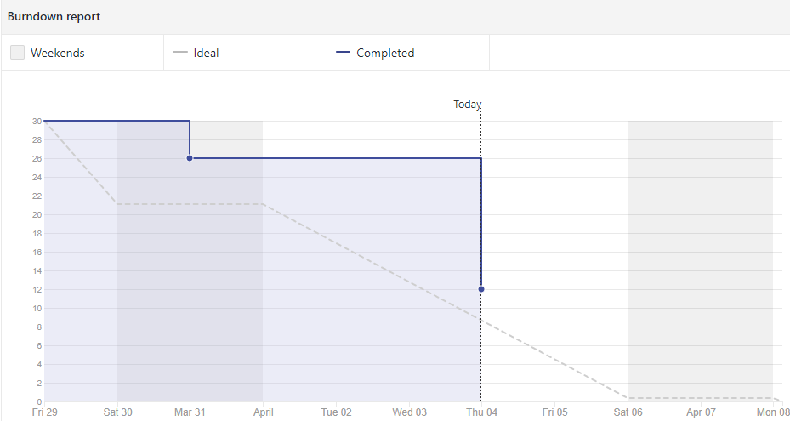
Burndown Report (Last Sprint)

Slide 3
Sprint 7 Responsibilities
Charles Stamey - Settings. Re-implemented due to lost files.
Guylain Kibunzi - Implement Education and start put contents on the pages
Joshua Brown - Fix calendar UI to be offline. Clean up Hot Dial UI. Creating models for modules.
Brian Goughnour - Implement message passing between goal tracker and calendar.
Chauncey Davidson - Continue Implementing Map events, Find Global Database

Slide 4
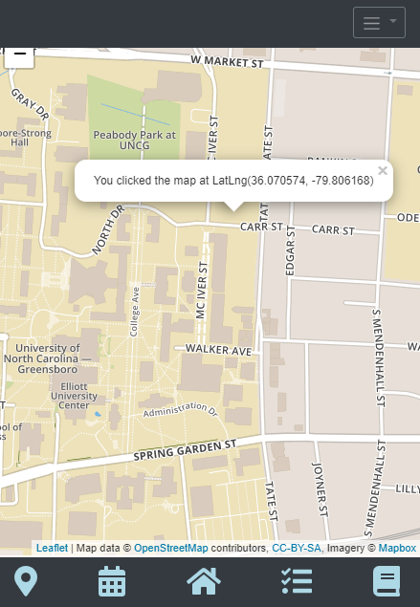
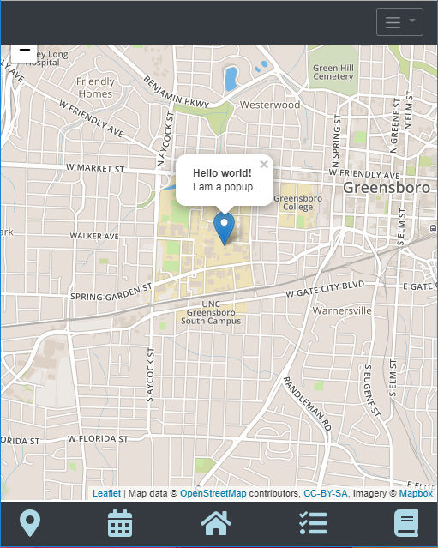
Map Updates

Slide 5
Future Sprint
Finish documentation on Hot Dial and Calendar
Education/Information section
Adding a predetermined list for the 5 Steps to Harm Reduction to Goal Tracker.
Repair button for Goal Tracker.
Final Touches on Map Implementation
Drawing Location info from SQLite
Map loading bug

Slide 6
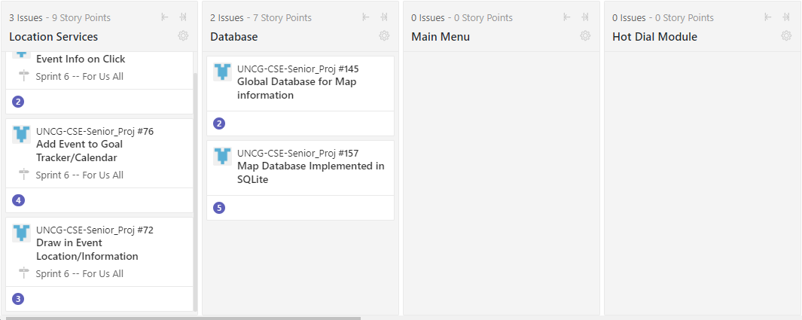
ZENHUB

Slide 7
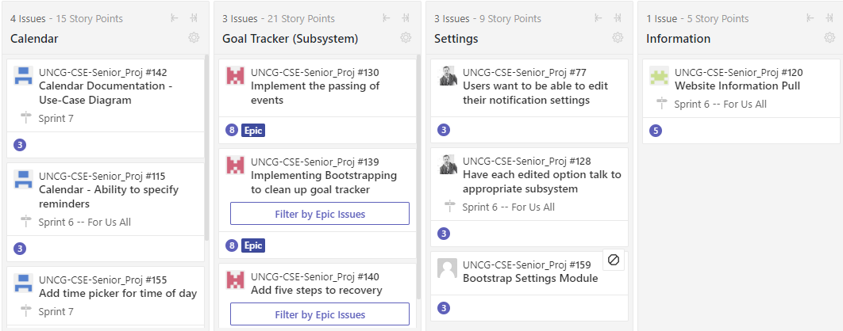
ZENHUB

